Slide 2
Thank you for attending!
Please note that your microphone has been muted to ensure that those attending are able to hear the presenters.
The chat function is also currently disabled. We will be enabling that function during the presentation.
Please type your name, union & questions about the presentation into the chat. Moderators will be will selecting questions to be answered by the panelists.
Sign in at: https://bit.ly/UUUtownhallsurvey

Slide 3
If you have questions about your specific circumstances please reach out to your union leadership!
Graduate Employee Organization
(GEO-UAW2322):
geo@umass.edu
Resident Assistant and Peer Mentors Union (RAPMU-UAW2322):
info@uaw2322.org
Postdoctoral Researchers Organizing (PRO-UAW2322):
info@uaw2322.org
Massachusetts Society of Professors (MSP-MTA):
msp@umass.edu
Professional Staff Union (PSU):
psu@external.umass.edu
American Federation of State, County & Municipal Employees (AFSCME):
local1776@external.umass.edu
University Staff Association (USA-MTA):
usa@external.umass.edu
Sign in at: https://bit.ly/UUUtownhallsurvey

Slide 4
Joint statement from
Representative Domb and Senator Comerford:
"UMass and our higher education institutions are the powerful and necessary economic engine that keeps our region running, and that engine does not run without UMass' workforce. Investments in this workforce and in our higher education system will be a crucial part of an economic recovery from COVID-19.
As our Commonwealth considers how best to emerge from this crisis, we'll be fighting for funding for our higher education system, and for UMass, and striving to do so at a level that ensures our UMass workforce has the economic security needed to continue this crucial work.
You have both our deep gratitude and our solidarity. Now and in the days ahead.''

Slide 5
Statement from
Representative Natalie M. Blais
“As one of the largest employers in the region and one of the most respected public research universities in the nation, the impact of UMass Amherst can not only be felt in our local economy but also in the economic trajectory of our great Commonwealth. The University's mission of education and research are key to the Commonwealth's emergence from the COVID 19 pandemic and that mission cannot be achieved without its world-class faculty and staff. The state's financial support of UMass Amherst has always been important but never more critical than it is today.”

Slide 6
Statement from
Representative Paul Mark:
"Thank you all for the good work you continue to do during these trying times. I am honored to say that I am a graduate of the Labor Center at UMass, a dues paying member of the MTA, and a local legislator committed to supporting and advancing public higher education and opportunity for all students.
This is an important time for all of us and that means it is a time to stand up, speak out, and work together to preserve all that has already been accomplished. We must all take action and make every effort to avoid unnecessary budget cuts and to affirm that this State of Emergency cannot be used an excuse to force bad ideas upon our community.
We must all join together in solidarity and remember that when we stand together, we win."

Slide 8
UMass Amherst Unions Represent
8,750
More union members than at any other workplace in New England!
Administrative Staff, Assistant Residence Directors, Classified Supervisors, Clerical Staff, Custodial Staff, Food Services Staff, Ground Staff, Housing Staff, Librarians, Non-Tenure Track Faculty, Peer Mentors, Postdoctoral Researchers, Professional Staff, Resident Assistants, Security Staff, Teaching and Research Assistants, Technical Staff, Tenure System Faculty, and Trades Staff.

Slide 9
Thank you for attending!
Please note that your microphone has been muted to ensure that those attending are able to hear the presenters.
The chat function is also currently disabled. We will be enabling that function during the presentation.
Please type your name, union & questions about the presentation into the chat. Moderators will be will selecting questions to be answered by the panelists.
Sign in at: https://bit.ly/UUUtownhallsurvey

Slide 10
Agenda
Update on how austerity is impacting the whole UMass system and all of us
Austerity Myth Busting
Questions and Discussion
Taking Collective Action—Please stay for the whole meeting so we can take action together
Sign in at: https://bit.ly/UUUtownhallsurvey
Notes:
MC (12:07-12:10) -- review agenda; reinforce when questions will happen
Kick it to first PRESENTER

Slide 11
Austerity:
A set of political-economic policies
Goal to reduce government spending on public services
State debt or low tax revenues often used as the excuse for making the cuts
Creditors and credit rating agencies threaten state/institutions with bad ratings (and higher borrowing costs) to push austerity measures
These policies are known to increase unemployment, deepen poverty, and increase inequality.
Who profits from austerity? Lenders/Investment bankers & privatizers.
The opposite of austerity is stimulus spending (public sector spending).
Notes:
Examples of people capitalizing on this crisis:
Nathaniel Davis, CEO of K12 Inc (for-profit online school) – Joined the right-wing Heritage Foundation’s National Coronavirus Recovery Commission, which promotes expanded virtual learning
Sec of Ed DeVos: already used over $300 m in discretionary federal grants to launch a new virtual education program (which will most likely favor charter schools)
NYT 5-15-20 DeVos uses corona funds to give to private schools

Slide 12
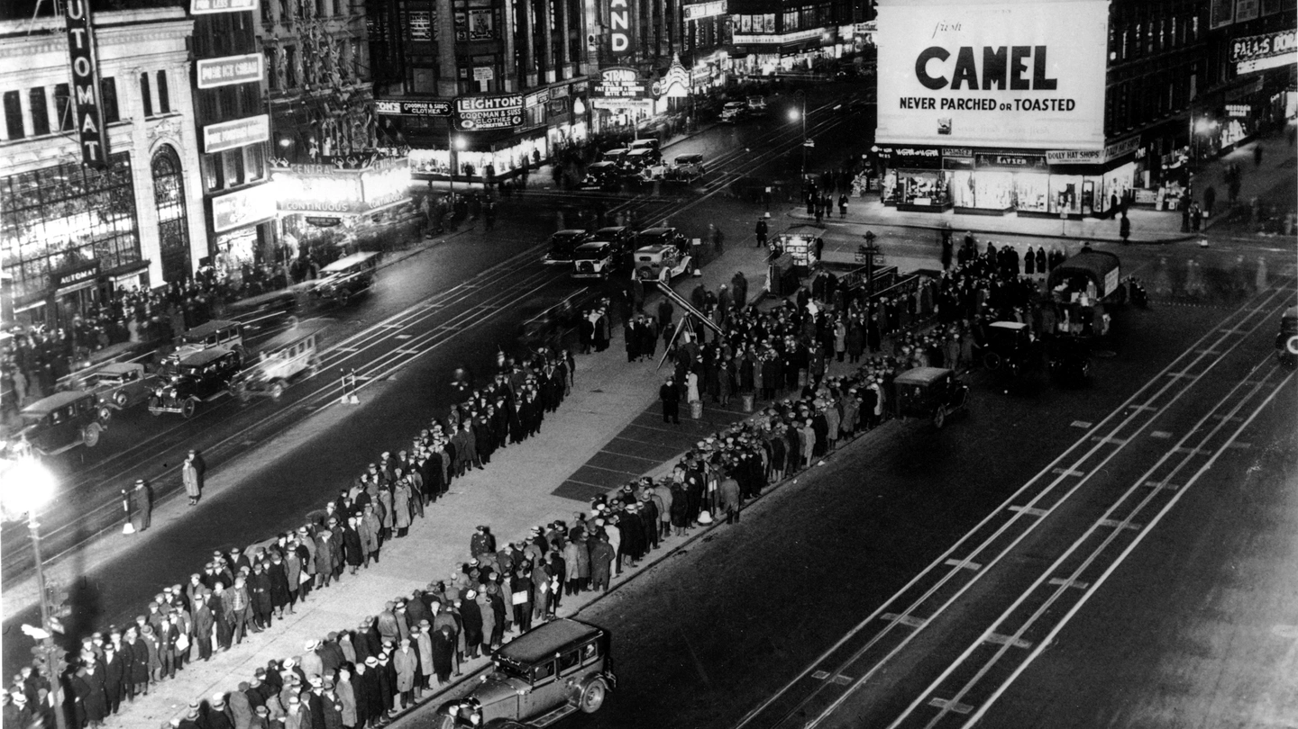

Slide 13
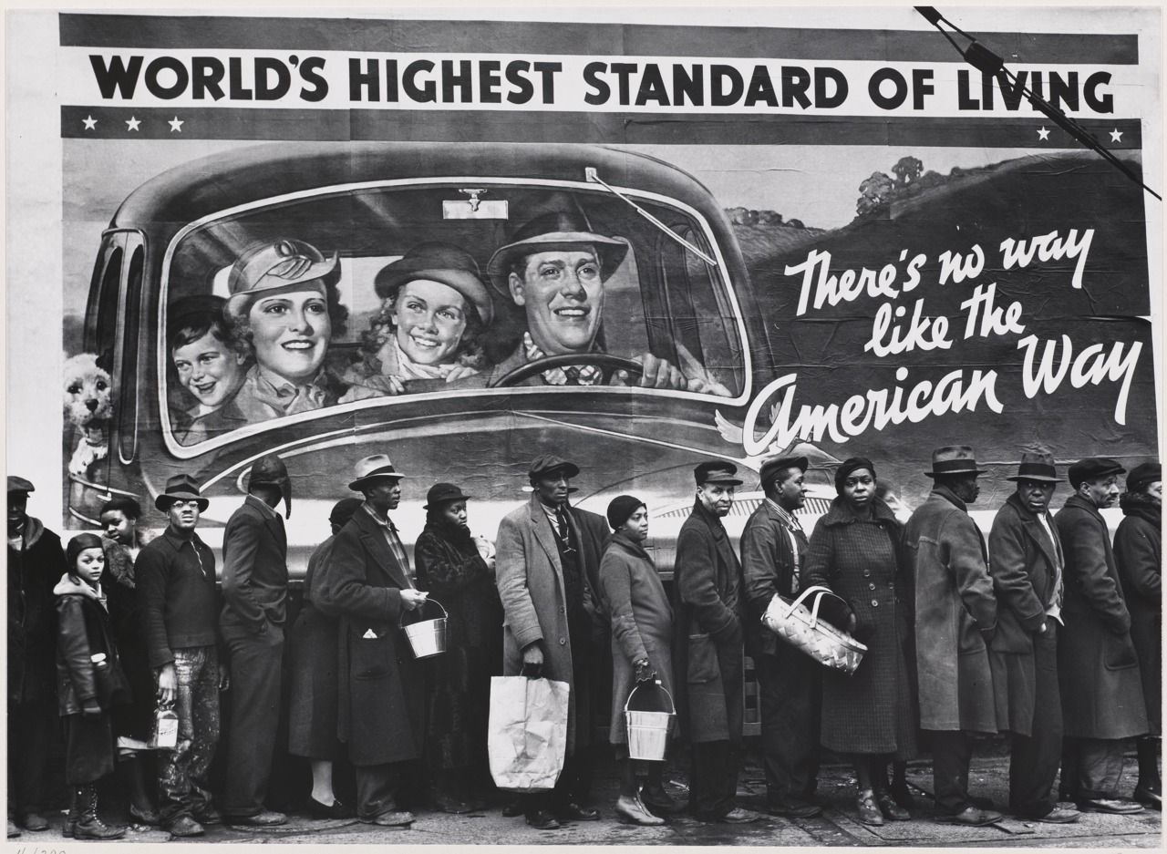

Slide 14
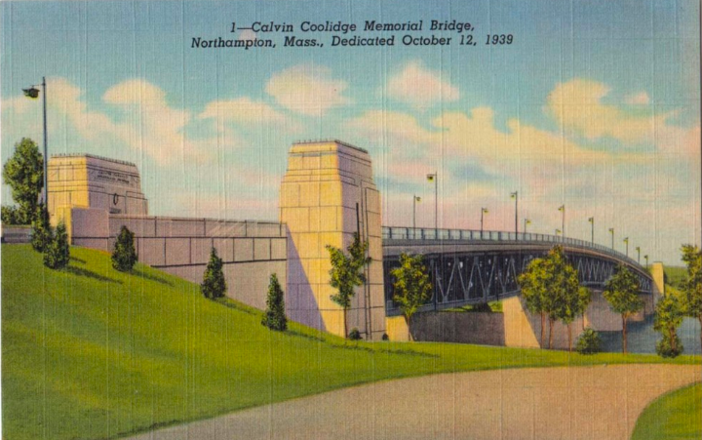
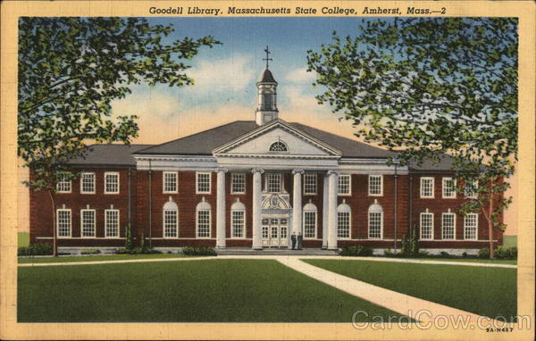
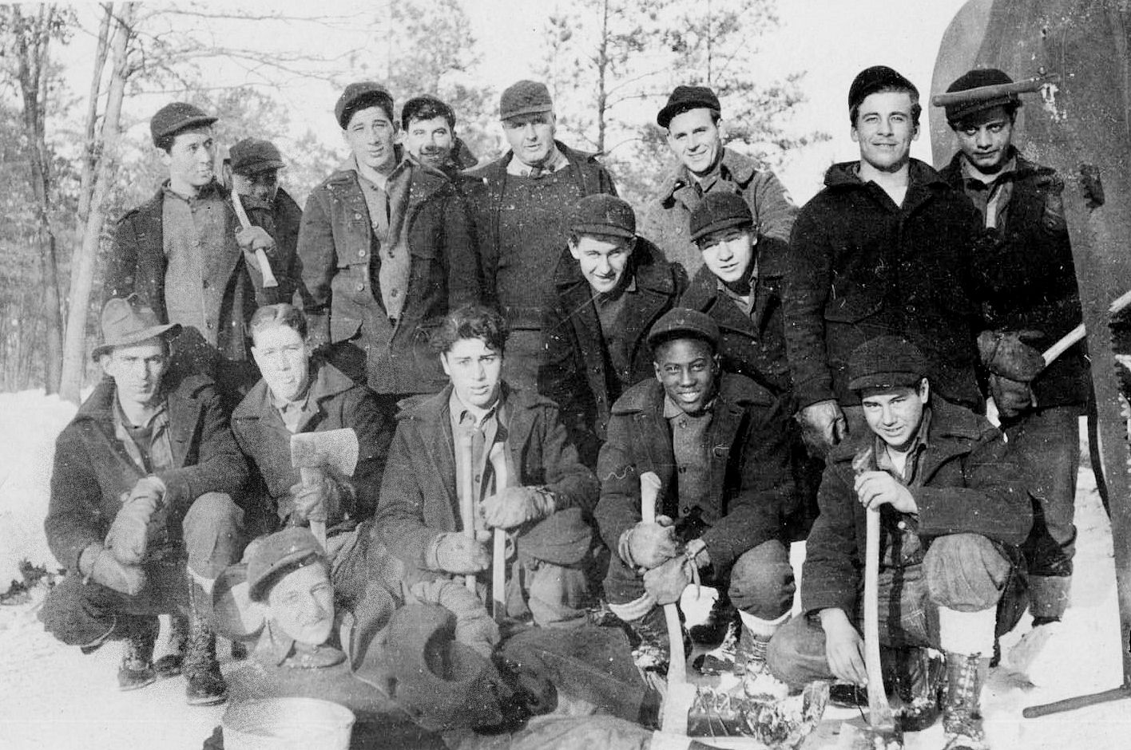

Slide 16
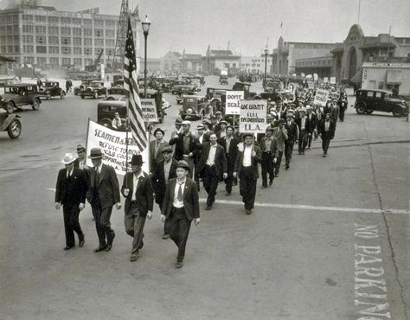
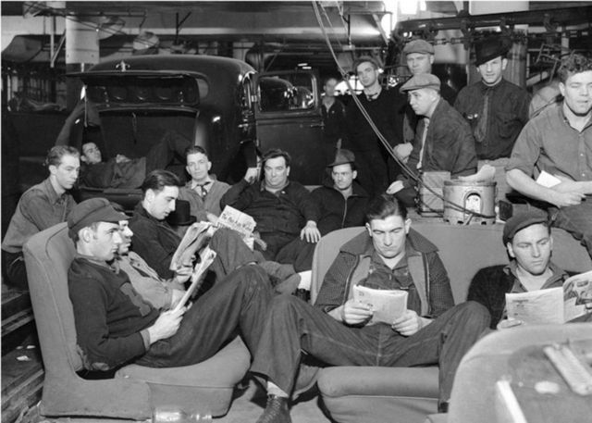
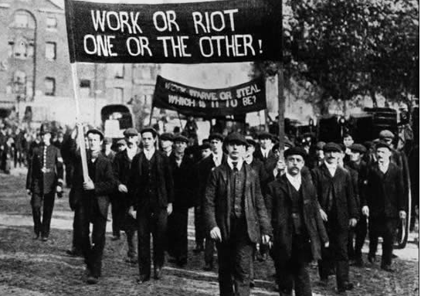
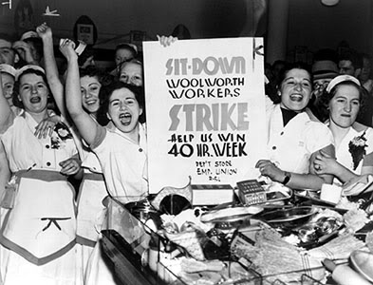

Slide 17
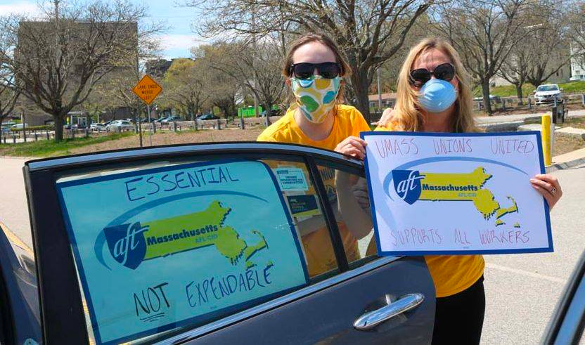
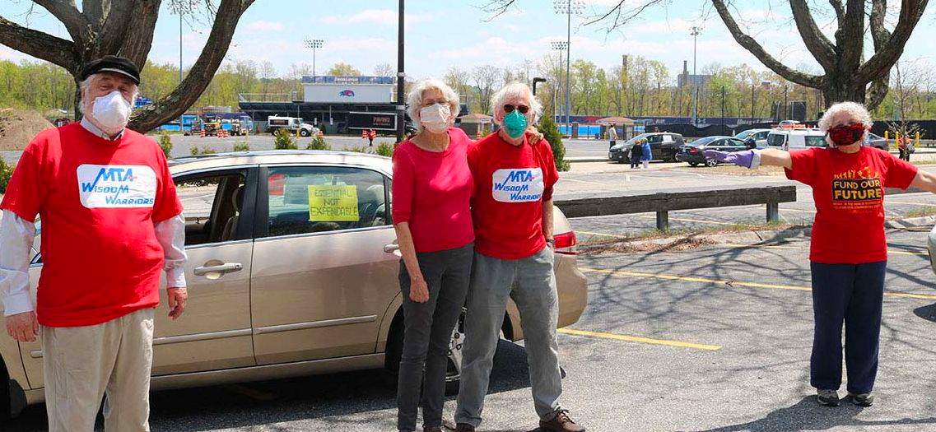
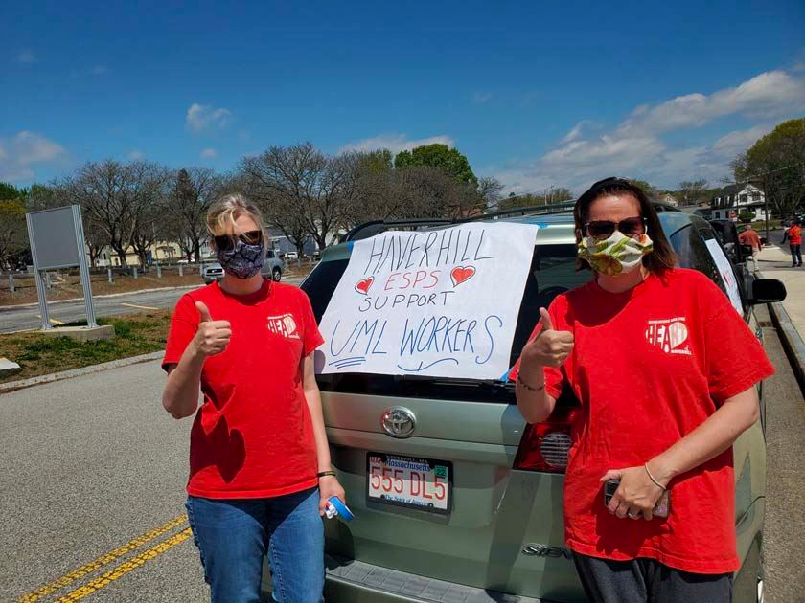
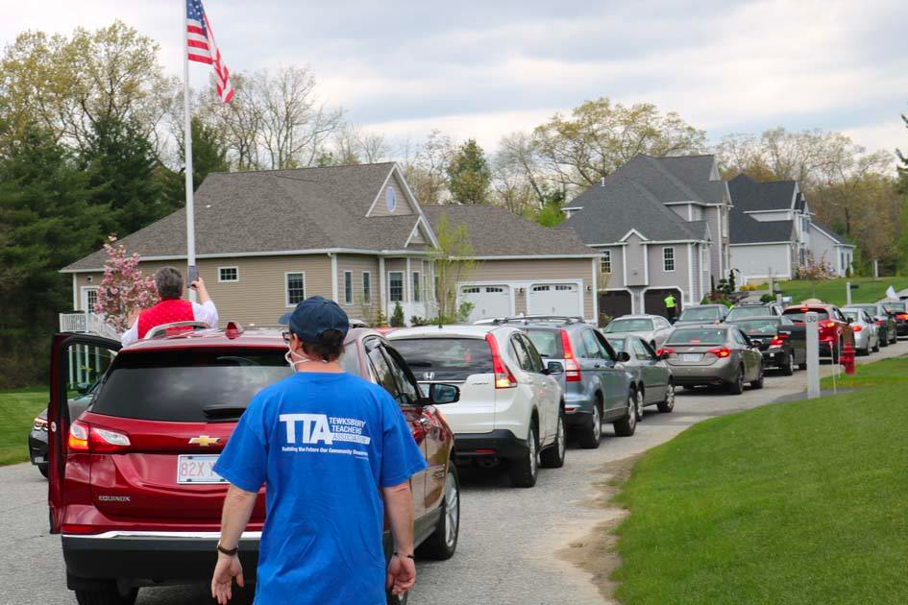

Slide 18
Austerity Myth Busting
Myth 1: We must have a balanced budget in FY20 The only body requiring us to have a balanced budget this year is the UMass Board of Trustees. We have run deficits before—that’s what our campus reserves are for.
Myth 2: We have no money and we won’t have any money First, we don’t yet know what next year holds: how many students will register? How much federal aid will there be for Massachusetts and UMass?
Second, there are other UMass funds that can be used: stabilization funds, savings from cancelling management consultants (which alone totalled $140M last year), refinancing debt. UMass is not poor.
Myth 3: We must all share the pain Cutting jobs and increasing unemployment is bad for everybody: for workers, for our families, for our communities, for our local economies, and for recovery!
Notes:
PRESENTER (12:26-12:34 -- 8 minutes) 1 of 2 slides

Slide 19
Questions and Discussion
Please type your name, union & questions about the presentation into the chat.
Moderators are reviewing questions and will select questions to be answered by the panelists.
Don't forget to sign in at: https://bit.ly/UUUtownhallsurvey

Slide 20
Taking Collective Action Right Now!
Sign on to the UMass Unions United letter to President Meehan & UMass trustee board: https://actionnetwork.org/petitions/tell-umass-president-marty-meehan-no-cuts-to-personnel/
Send an email to your state senator and state representative calling on them to fight for federal aid for public higher ed and for no public sector layoffs or furloughs https://actionnetwork.org/letters/tell-our-state-legislators-umass-works-because-we-do/manage
Post your ideas in the chat: What creative actions can we do (while maintaining social distancing) to pressure President Meehan and our Trustees to keep all UMass workers employed?
8-11 tonight Station Marty Meehan is on WBZ. Call in 617-931-1030 and ask this question
Fill out the form to show your commitment to further action as needed
Notes:
PRESENTER (12:36-12:42 -- 6 minutes) 2 of 2 slides
**Tech support: drop the links in the chat so people can click on them now!
There are 3 things we want you to do right now.
The UMass Unions United coalition sent a letter to President Meehan, calling on him to keep everybody employed, find other places for savings than our wages and jobs, work with us to fight for more Federal aid, and negotiate with us to ensure we’re all safe when our campuses begin to re-open. THE LINK FOR SIGNING ON TO THIS PETITION IS IN THE CHAT.
Once you’ve done that, send an email to your State Senator and Representative. There’s a second link in the chat for you to take this action. This will help put public pressure on UMass to do the right thing in this crisis.
We’re going to keep putting pressure on Meehan, Manning and Baker. The last thing we need you to do is share your ideas for creative--but safe--collective actions. Put them in the chat now, or send them to your union later. But, be ready to participater.
Kick it to last PRESENTER

Slide 21
UMass Unions Unite!
Together We Win The Fight!

Slide 22
Thank you for attending!
If you have questions about your specific circumstances please reach out to your union leadership!
Graduate Employee Organization
(GEO-UAW2322):
geo@umass.edu
Resident Assistant and Peer Mentors Union (RAPMU-UAW2322):
info@uaw2322.org
Postdoctoral Researchers Organizing (PRO-UAW2322):
info@uaw2322.org
Massachusetts Society of Professors (MSP-MTA):
msp@umass.edu
Professional Staff Union (PSU):
psu@external.umass.edu
American Federation of State, County & Municipal Employees (AFSCME):
local1776@external.umass.edu
University Staff Association (USA-MTA):
usa@external.umass.edu
Let us know you were here! https://bit.ly/UUUtownhallsurvey

