Slide 1
University Staff Association
^{Annual Membership Meeting}
September 15, 2021 - noon to 1:00 pm
Notes:
Leslie:
Welcome to the University Staff Association's Annual membership meeting. We have a lot to talk about today including a vote on our proposed FY22 budget.

Slide 2
Thank you for attending!
Please note that this is a meeting for University Staff Association (USA) Members
If you are not a member of the USA union, we respectfully ask that you leave.
Your microphone has been muted to ensure that those attending are able to hear the presenters.
Chat will be disabled until the end of meeting and available during the Q&A.
This will be a large meeting which will limit presenters' ability to engage with questions. If you have a question that needs follow-up, please connect with a steward, officer or board member.
Slides will be posted on our website: https://universitystaffassociation.org/
This meeting is being recorded

Slide 3
A Year-in-Review 2020 - 2021
March 2, 2020: USA, PSU & AFSCME started conversations with the Administration regarding the COVID-19 outbreak and plans to keep staff & students safe
September 14, 2020: The second all-staff furlough; this time for 2 weeks
October 18, 2020: A total of 57 USA members were placed on indefinite furlough or reduced hours
March 13, 2020: COVID-19 hit fast, and the Campus became a ghost town; sending most staff home to work remotely; and USA members proved we could do this successfully
February 7, 2021: USA members on indefinite furloughs started to be slowly called back
March 24, 2020: USA, PSU & AFSCME signed the first of 7 MOUs (Memorandum of Understanding) to protect as many members as possible during the pandemic
April 11, 2021: The majority of USA members on indefinite furloughs have been called back to work; a few remained on a reduced schedule but were able to take advantage of the unemployment workshare program
May 15, 2020: The first of two VSIPs (Voluntary Separation Incentive Program) was offered to staff. A total of 96 USA members opted to take one of the two VSIPs
July 12, 2021: USA signed a Flexible Work MOA to allow more flexible and remote work options
May 31, 2020: The first all-staff furlough for 1 week
A New Year is a time to step FORWARD
Notes:
Play Donna’s song

Slide 4
Agenda
Introduction of Officers & Stewards
Annual Budget Presentation for FY22 & vote
Health & Safety updates
Flexible/Remote issues – brief survey coming
Bargaining & Other updates
Q&A (limited time using chat)

Slide 5
USA Officers and Board Members
President: Leslie Marsland
Vice President: Mary Malinowski
Treasurer: Donna Vanasse
Recording Secretary: Dora Ramos
Grievance Officer: Linda Fish
Chief Steward: Sheila Gilmour
Health & Safety Coordinator: Casey Krone
Membership Coordinator: Sue Randall
Classification Specialist: Christine Langlois
Communications & Public Relations Coordinator: Jackie Bishop (also USA’s Office Manager)
Political Action & Social Justice Coordinator: Kai Strickland
Coordinator of Special Projects: Tricia Gibney (also the USA Health & Welfare Trustee)
MTA Field Rep: Miles Stern
Classification Committee: Melinda Lelacheur and Rachel Lavery
Bargaining Team: Leslie Marsland, Mary Malinowski, Linda Fish, Sheila Gilmour, Donna Vanasse, Jackie Bishop, Barbara Hastings, Daniela Scales, Heather Deirdre, Jonah Carlson, Keith Parenteau, Michelle McBride, Miles Stern (MTA)
Stewards: Dora Ramos, Barbara Hastings, Jonathan Sliva, Andrew Serra, Heather Deirdre, Daniela Scales,Thor Hansen
Notes:
Leslie: Welcome new board members Sue Randall & Tricia Gibney
Also special thanks to the Classification Committee & Bargaining Team.
I want to recognize our stewards as well.
And a big shout out to Dave Litterer and the Elections committee for all their work with our elections and the updated constitution changes.

Slide 6
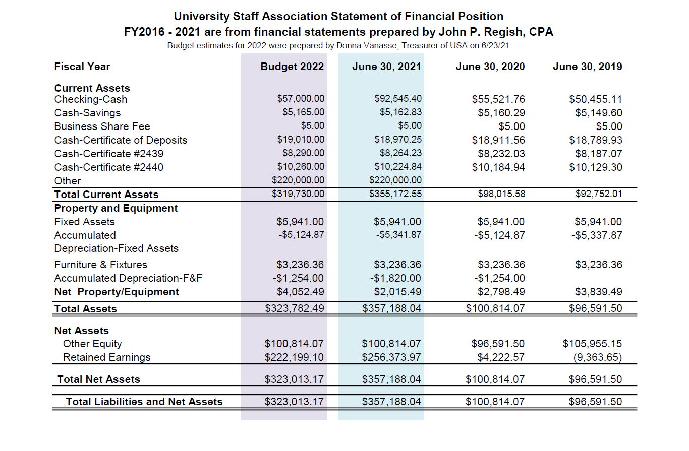
Fiscal Year 2022 Budget
Notes:
This budget was prepared on June 23, 2021 based on bank statements which are reconciled quarterly by our Certified Public Accountant -
Review Checking, Savings, CDs, Total Assets
Property and Equipment had no significant changes
-Note the significant increase to the bottom line in FY21 which was due to an insurance settlement that took a couple of years to be paid out.
Explain that the Budget for FY22 (lilac) is a conservative prediction based on the previous years’ figures.

Slide 7
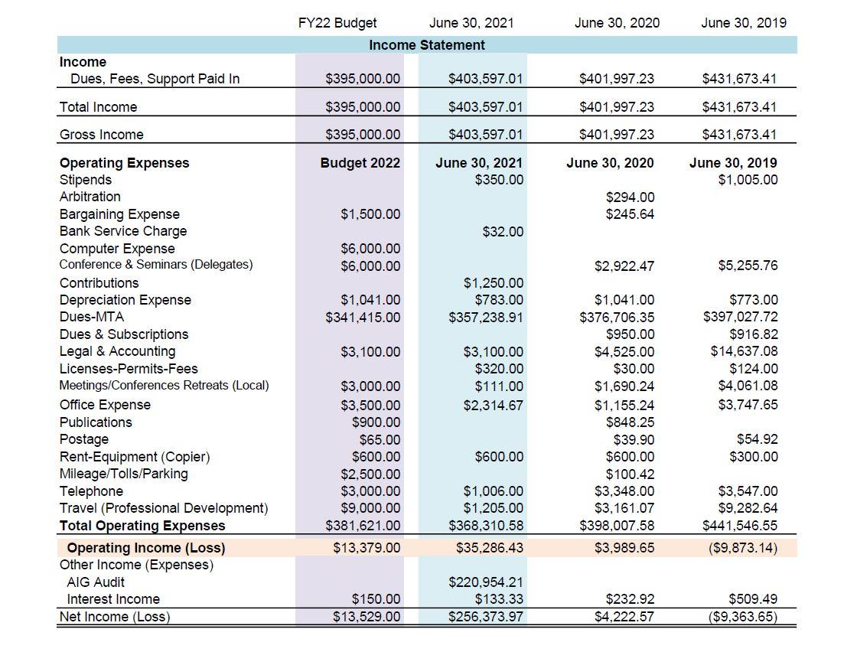
Fiscal Year 2022 Budget
Note: FY21 net income is $35,419.76
Notes:
Begin the Income Statement with FY21 Actuals (blue). Point out income (dues) mention decrease in membership due to Voluntary Separation and hiring freeze. My estimate was conservative and the rate of hiring has dramatically increased in the past couple of months.
Discuss expense estimates based on FY20 and FY19. Note the Net Income/Loss for each fiscal year. (Point out that any increase/decrease in membership will offset both income and expenses.) The bottom line is a prediction of Net Income retained. Read the net income/loss for each previous year. After subtracting out the settlement, the Actual Net income in FY21 was $35,419.76- far fewer expenses during the pandemic. The income statement for FY22 could change from this budget based on unexpected expenses. We are updating our computers, we included money for attendance at MTA and NEA conferences similar to previous fiscal years; Applying for scholarships or virtual events could reduce those expenses.
Bottom line: prediction net income of $13,529.00 for this fiscal year. Brief Q&A before taking a vote to accept or reject this budget.

Slide 8
Health & Safety

Slide 9
Bargaining Updates
6/14/21: 1st meeting with Management; presented 3 coalitions proposals:
#1: Salary proposal: 4% each year; additional 1% top step; $1,000 to base
#2: Campus Closure Days: Wednesday before & Friday after Thanksgiving; All days between Christmas & New Year Day Holiday (12/24 – 1/2)
#3: Childcare: Using federal funds stimulus funds to: Build and expand Child Care facilities; increase staffing; offer infant care; adjust fees (sliding scale)
7/12/21: 2nd meeting with the administration: cancelled by the administration.
9/17/21 :Next meeting 9/17/21(after several requests to resume bargaining)
To date, we have received no counters (or rejections) on the above.
Notes:
Leslie: USA and other UMass/Amherst unions have joined together in a coalition to present proposals common to all. Above are 3 of these proposals and we are working on more.
Also, USA has join in another coalition with units from across the whole UMass system. This coalition includes classified staff (us) from all the UM campuses. Unions such as AFSCME (normally trades), SEIU (clerical), SHARE (medical school), CSU/Boston, MTU/Lowell have come together to equalize benefits, and other contract items, to the be the same on all campuses. We are putting together proposals that will be presented at EVERY unit’s table.

Slide 10
Bargaining: Salary Increases
Chancellor’s email 7/21/21: The state has authorized salary increases of:
up to 1.5% of salary as a one-time non-base COVID adjustment
2.5% retroactive base salary increase for FY21.
2% base salary increase in FY22.
Other Units that have settled:
2.5% wage increases, retroactive to the first pay period of January 2020
2% wage increase, retroactive to the first pay period of January 2021
2% wage increase effective the first pay period of January 2022
1.5% COVID Recognition Bonus based on your salary rate with a minimum of a $1,000 bonus
Notes:
Leslie: We fully believe that our salary proposal will be rejected (or countered) with the parameters that the Chancellor outlined in his email sent 7/21/21. However, we will continue to ask for better and demand to get what other State units have received.

Slide 11
Bargaining: What is next?
Below are some proposals that we are working on in general:
Updating language to be consistent in our contract; there are places where language contradicts itself.
Flexible and Remote language: Management does expect, and encourages, a proposal to update current flexible language to include remote language.
Reclassification process - Management has asked that we visit this language and update.
H&S issues.
Adding more titles into USA.
Equalizing benefits across the UMass system – a coalition proposal.
“Green New Deal/Climate Justice”: expanding carpooling, electric vehicle charging stations, zero emissions, better heating/cooling in buildings, hazard abatement, air quality, promote remote work, additional closure days to name a few. This is a coalition proposal.
Notes:
Leslie: Because we haven’t presented our other proposals to management yet, please understand the need not to share them in detail until presented. We don’t want management to have advance notice and be ahead of us.

Slide 12
Other Updates
Brief survey on flexible/remote/hybrid work arrangements for fall (October on) - please complete the survey.
USA is trying to track where there are inconsistencies and delays in responses to requests.
USA is also tracking Medical Accommodation requests and the timeless of decisions.
Applying for vacancies: We want to hear from you when you feel that you are being bypassed for an open USA position for which you applied for and have the minimum qualifications.
OTW (Out-of-Title Work): If you are doing work that is above your current grade, or work that belongs to another union, PLEASE contact us.
Volunteers - Looking for members interested in helping USA:
Steward positions: training provided
Contract Action Team Members (CAT): to help with actions around bargaining issues (especially those proposals that get rejected)
Reclassification team members: to help members seeking a desk audit/upgrade
Notes:
Leslie:
Survey - we are trying to determine where there are inconsistencies in approving flexible/hybrid or remote requests for USA members. It’s important to complete this survey so we can identify problem areas. Only Miles and myself have access to the names of those responding and will not share that information. We are trying to collect data based on departmental approvals and denials.
Applying for Vacancies: USA has pushed and pushed for the administration to abide by our contract that states that USA members have access to USA job posting 7 days in advance before the posting is open to the public. This not being followed and we are concerned that USA members are not being considered for positions that they apply to, especially when they meet the minimum qualifications. If you feel bypassed, please reach out. The university had purchased a module that will follow our contract for page up but currently is experiencing a problem before they can go live.
OTW - will all the VSIPs that happened, we believe that many USA members did, and still are, taking on work that was being done by someone in a higher USA graded position or PSU. If you think this applies to you, please reach out to us. You may be entitled to additional salary per our contract.
CAT: Contract Action Team members will be called upon to take part in actions that will help to secure a better contract – informing coworkers, wearing stickers, caravans, sign holding, signing petitions, and participating in other worksite activities that lets the administration know that we are serious.

Slide 13
Q&A
We will open the chat function just before we start the Q&A.
Please take some time to locate that feature. It will be located at the bottom of the participants window and should look like this
Due to the complexity of the meeting, we are unable to process all questions that are asked in the chat but will try to answer those that apply to all members.
Questions specific to your position, or you, should not be asked in the chat.

Slide 14
If you have questions about your specific circumstances, please reach out to your union leadership!
University Staff Association Office (for general inquiries): usa@external.umass.edu
Leslie Marsland, President: marsland@umass.edu
Mary Malinowski, Vice President: mary.malinowski@umass.edu
Casey Krone, Health & Safety Officer (for H&S Issues): ckrone@honors.umass.edu
Linda Fish, Grievance Officer (for Grievance & contract issues): lfish@library.umass.edu
Sheila Gilmour, Chief Steward (for Grievance & contract issues): sgilmour@umass.edu
Miles Stern, MTA Field Rep: MStern@massteacher.org
Stewards – please visit our website to locate the steward for your area

